Slide 1
Math 769: Statistical Learning

Slide 2
Bayesian Inference
Shahrzad Jamshidi, PhD

Slide 3
Last Time
We discussed maximum likelihood inference as a method for finding parameters in a model.
The method involves constructing the log-likelihood function and finding the values of the parameters that maximize the function.
Conceptually, this technique is finding the model for which our dataset is the most likely.
Sometimes the estimates from this technique are biased.

Slide 4
Objectives
Understand the basics of Bayes' Theorem.
Explore how Bayesian Inference differs from the frequentist approach.
Learn the process of constructing models using Bayesian methods.

Slide 5
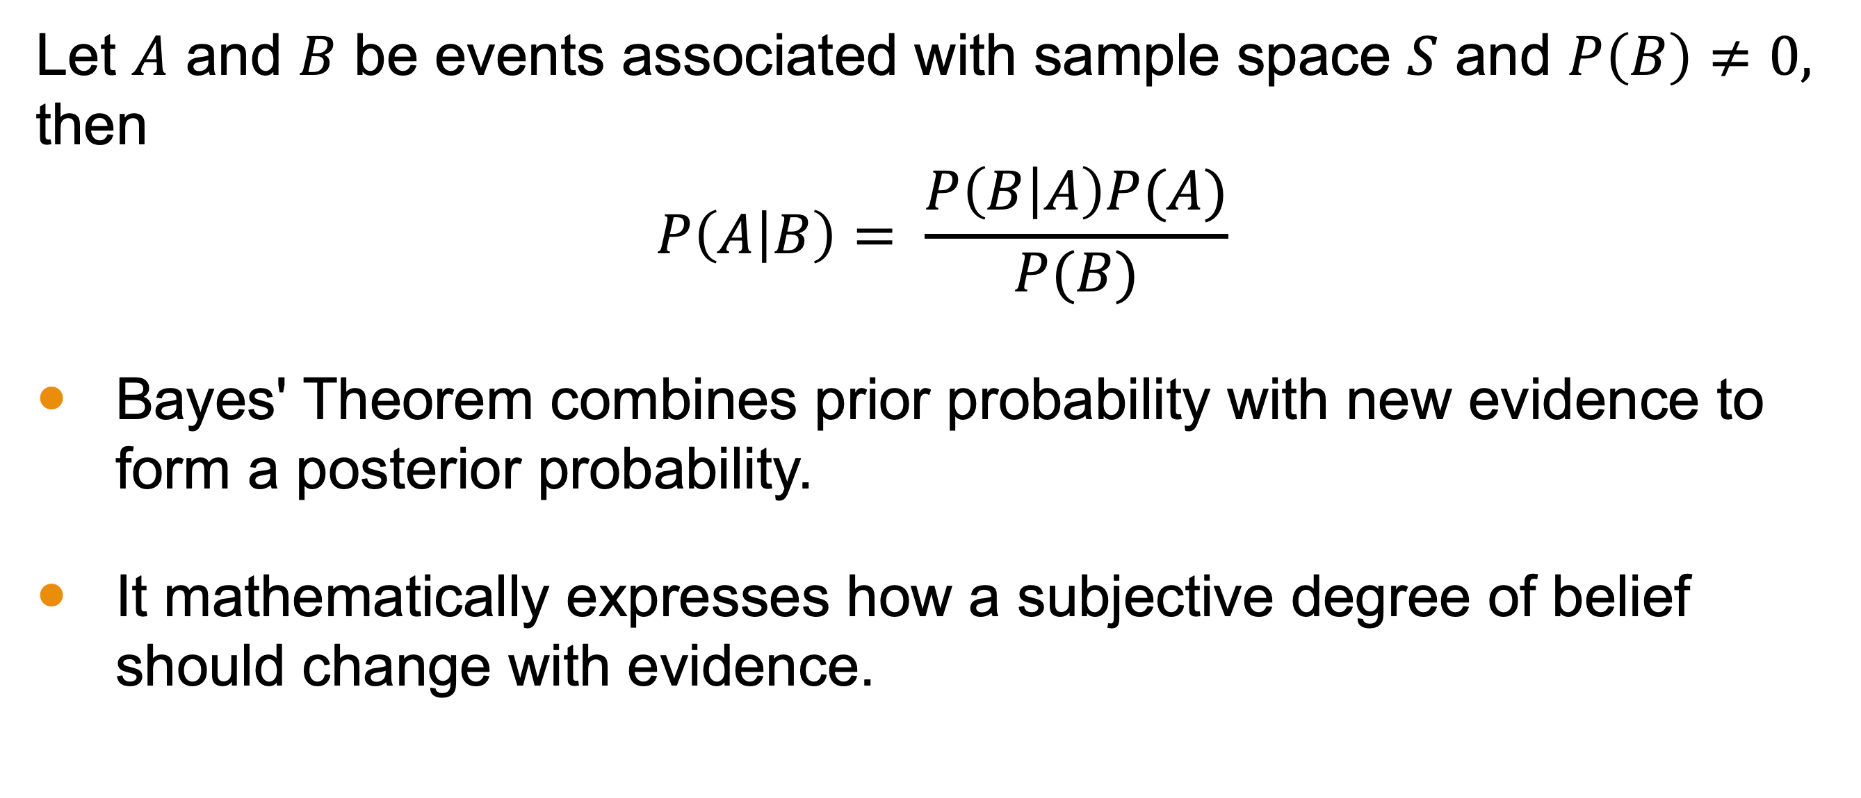
Bayes Theorem
Let $A$ and $B$ be events associated with sample space $S$ and $P\left(B\right)≠0,$ then
$$P\left(A | B\right)= \frac{P\left(B | A\right)P(A)}{P(B)}$$
Bayes' Theorem combines prior probability with new evidence to form a posterior probability.
It mathematically expresses how a subjective degree of belief should change with evidence.

Slide 6
Bayes vs. Frequentists
In the standard (“frequentist”) inference, probabilities are interpreted as long-run frequencies.
In the Bayesian inference, probabilities are interpreted as subjective degrees of belief.
The prior distribution, which is a or belief, gets updated in the face of evidence.
The posterior distribution is a reflection of that update.

Slide 7
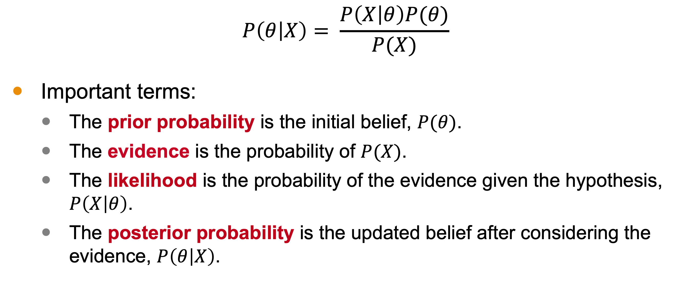
Bayes Theorem
$$P\left(θ | X\right)= \frac{P\left(X | θ\right)P(θ)}{P(X)}$$
Important terms:
The prior probability is the initial belief, $P(θ)$.
The evidence is the probability of $P(X)$.
The likelihood is the probability of the evidence given the hypothesis, $P\left(X | θ\right)$.
The posterior probability is the updated belief after considering the evidence, $P\left(θ | X\right)$.

Slide 8
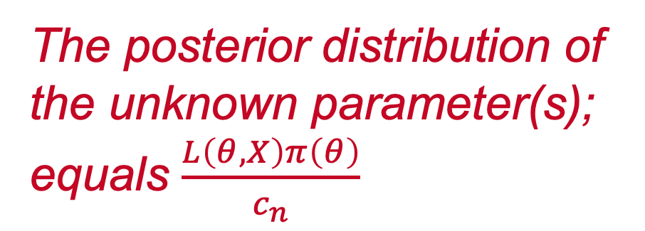
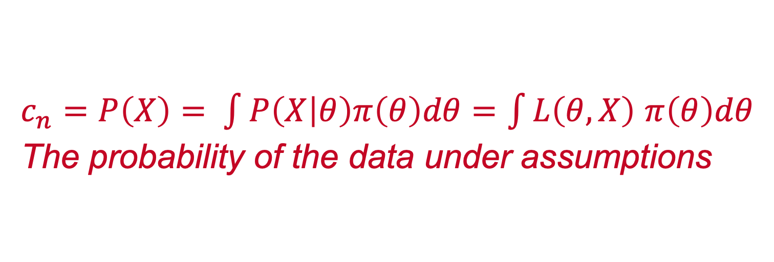
Bayes Inference from Bayes Theorem
The prior distribution of the unknown parameter(s).
The statistical model
$$P\left(θ | X\right)=π(θ)\frac{P\left(X | θ\right)}{P(X)}$$
The posterior distribution of the unknown parameter(s); equals $\frac{L\left(θ,X\right)π\left(θ\right)}{c_{n}}$
$c_{n}=P\left(X\right)= \int{P\left(X | θ\right)π\left(θ\right)dθ}=\int{L\left(θ,X\right)}$ $π\left(θ\right)dθ$
The probability of the data under assumptions

Slide 9
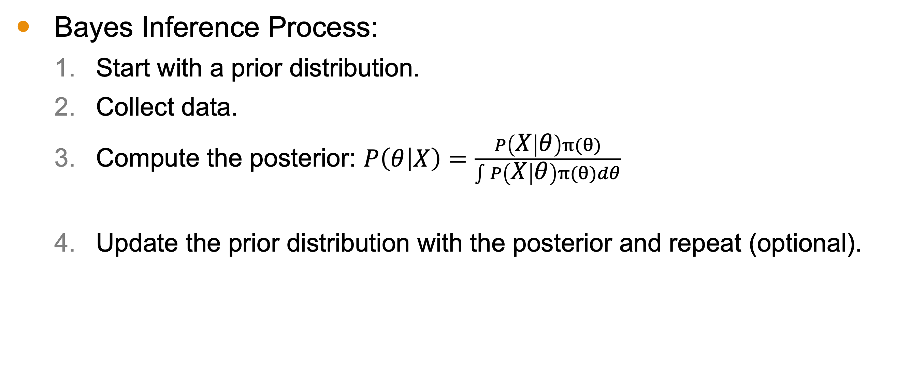
The Process of Bayes Inference
Bayes Inference Process:
Start with a prior distribution.
Collect data.
Compute the posterior: $P\left(θ | X\right)=\frac{P\left(X | θ\right)π(θ)}{\int{P\left(X | θ\right)π(θ)dθ}}$
Update the prior distribution with the posterior and repeat (optional).

Slide 10
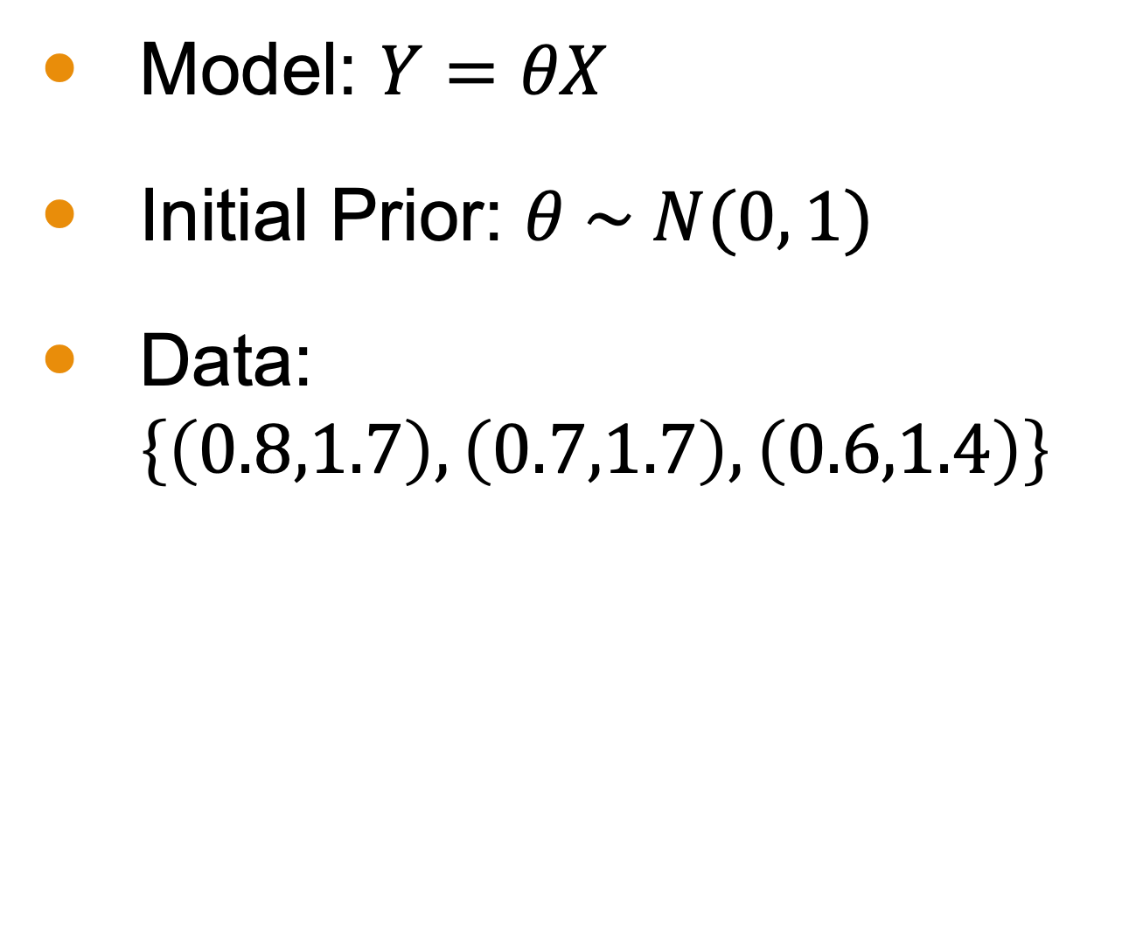
Example: Iteration 1
Model: $Y=θX$
Initial Prior: $θ \sim N(0, 1)$
Data: $\left\{\left(0.8,1.7\right),\left(0.7,1.7\right),\left(0.6,1.4\right)\right\}$
Posterior Mean: ~1.6
Posterior Variance: ~0.7

Slide 11

Example: Iteration 2
Model: $Y=θX$
Initial Prior: $θ \sim N(1.6, 0.7)$
Data: $\left\{\left(0.2,0.4\right),\left(0.2,0.5\right),\left(0.9,1.8\right)\right\}$
Posterior Mean about 1.8
Posterior Variance about 0.3

Slide 12

Example: Iteration 3
Model: $Y=θX$
Initial Prior: $θ \sim N(1.8, 0.3)$
Data: $\left\{(1.2,2.5),(1.9, 3.9),(1.8, 3.7)\right\}$
Posterior Mean about 2.0
Posterior Variance about 0.01

Slide 13
Example: Iteration 3
Model: $Y=θX$
Initial Prior: $θ \sim N(1.8, 0.3)$
Data: $\left\{(1.2,2.5),(1.9, 3.9),(1.8, 3.7)\right\}$
Posterior Mean about 2.0
Posterior Variance about 0.01
True distribution: N(2, 0.1)

Slide 14
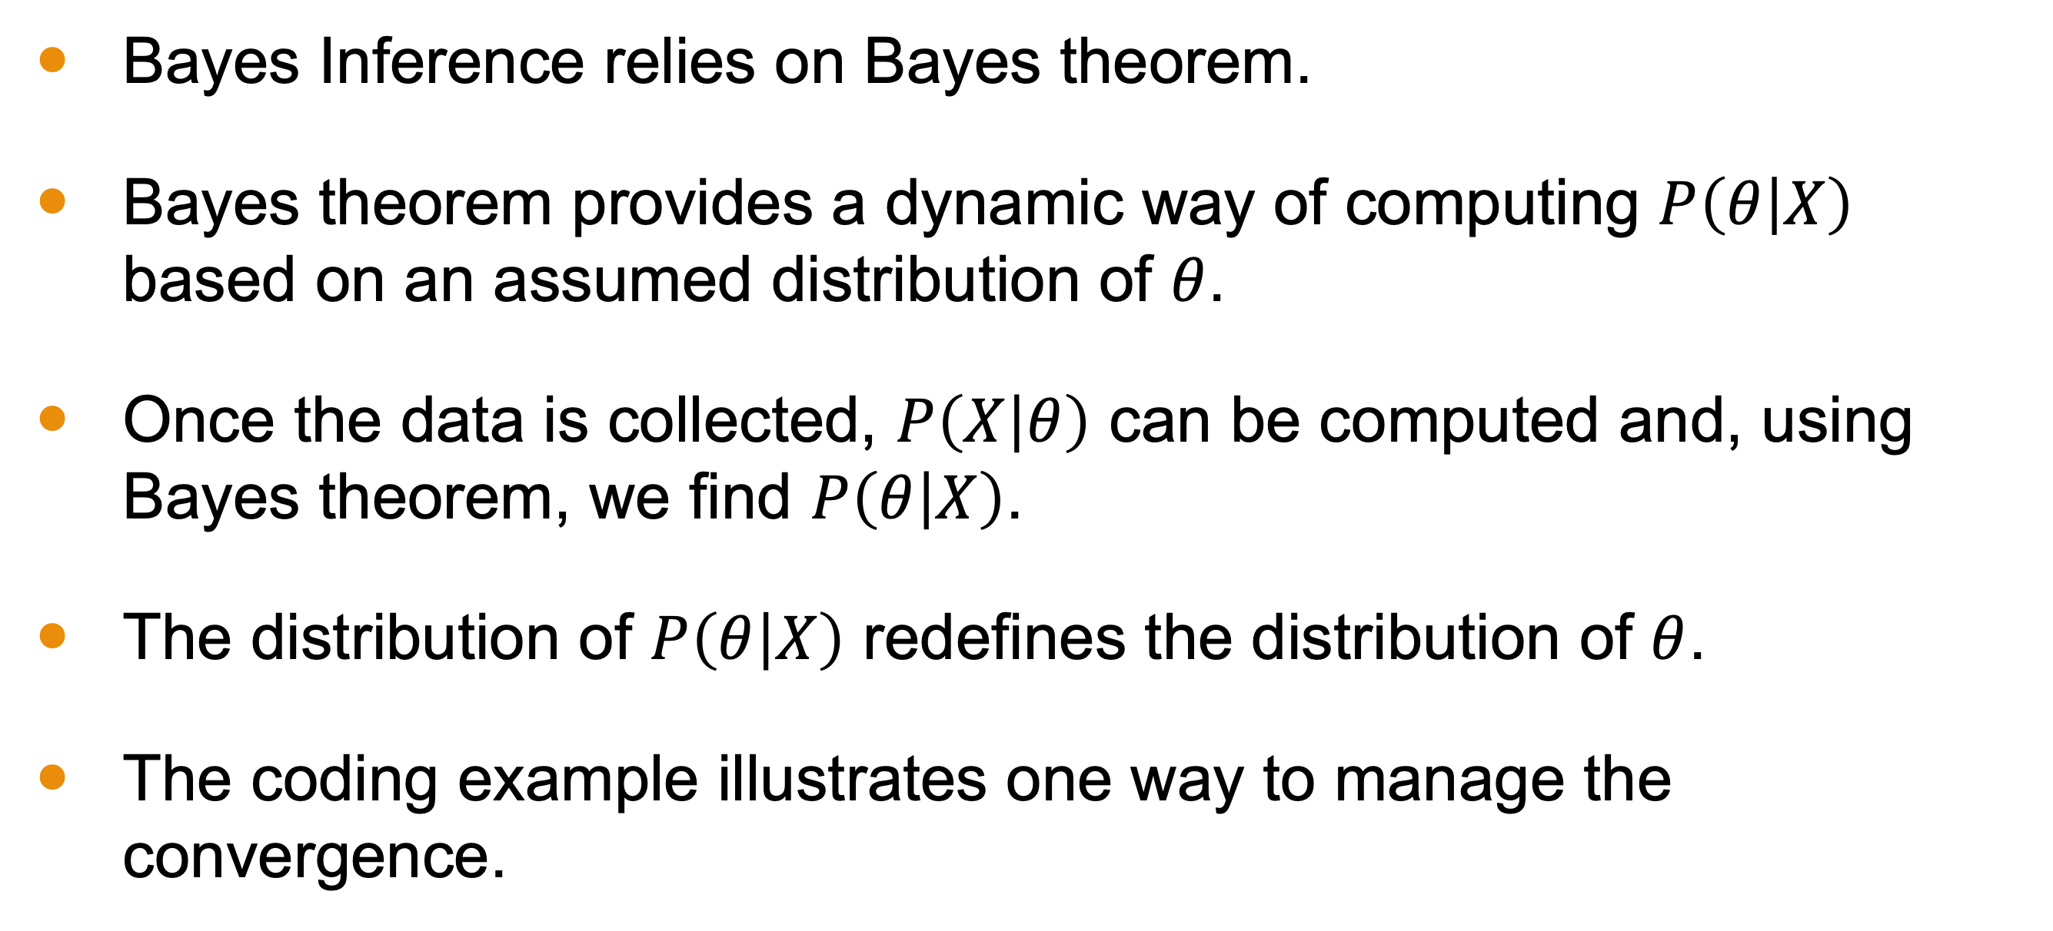
Conclusion
Bayes Inference relies on Bayes theorem.
Bayes theorem provides a dynamic way of computing $P\left(θ | X\right)$ based on an assumed distribution of $θ$.
Once the data is collected, $P\left(X | θ\right)$ can be computed and, using Bayes theorem, we find $P\left(θ | X\right)$.
The distribution of $P\left(θ | X\right)$ redefines the distribution of $θ$.
The coding example illustrates one way to manage the convergence.

